Slide 1

6th Grade Math
Unit 4, Lesson 6 Rational Numbers in Real-World Context Volume 1, pg. 161

Slide 2


Benchmark
MA.6.NSO.1.1
Extend previous understanding of numbers to define rational numbers. Plot, order, and compare rational numbers.
MA.6.NSO.1.2
Given a mathematical or real-world context, represent quantities that have opposite directions using rational numbers. Compare them on a number line and explain the meaning of zero within its context.
volume 1, pg. 161

Slide 3
Integrated Mathematical Thinking and Reasoning Standards
MA.K12.MTR.2.1 Demonstrate understanding by representing problems in multiple ways.
MA.K12.MTR.7.1 Apply mathematics to real-world contexts.
volume 1, pg. 161

Slide 4

Learning Targets
I can determine positive and negative values in relation to real-world contexts.
I can plot negative rational values given a real-world context.
volume 1, pg. 161

Slide 5

Warm-Up
volume 1, pg. 161

Slide 6

4.6.1 Warm-Up: Mathematician Katherine Johnson
Born in 1918, Katherine Johnson was always fascinated by numbers. Graduating from high school at 14 and from college at 18, she went on to become one of the first African American mathematicians with the job title of “computer” at NASA, where she worked for three decades. As a computer, she personally checked the calculations made by electronic computers. Katherine calculated the launch window for America’s first human space flight. Her calculations were critical to the success of the Apollo Moon landing program and the start of NASA’s Space Shuttle program.
volume 1, pg. 161

Slide 7
In 2015, she received the Presidential Medal of Freedom from President Obama. In its official announcement, the White House cited Katherine’s influence on every major space program from Mercury to the Shuttle Program.
What stands out to you the most about Katherine Johnson?
volume 1, pg. 161

Slide 8

Collaboration
volume 1, pg. 162

Slide 9

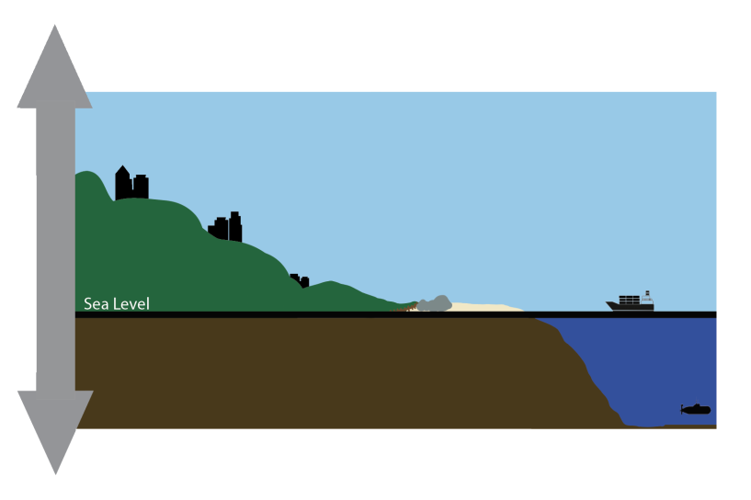
4.6.2 Collaboration: Exploring Elevation
The picture shows different locations relative to sea level.
Describe how the picture can be used to explain the word elevation.
volume 1, pg. 162

Slide 10
Ask two classmates for their description of the word elevation. Write their description in the table. You are the only person who should write in the first column of the table. Have your classmate initial next to your summary of their description stating that your summary is correct.
My Summary of _________’s Description of Elevation | Initials
My Summary of _________’s Description of Elevation | Initials
volume 1, pg. 162

Slide 11

Using the picture, name one thing that is below sea level.
Name one thing that is above sea level.
volume 1, pg. 162

Slide 12

Guided Instruction
volume 1, pg. 163

Slide 13
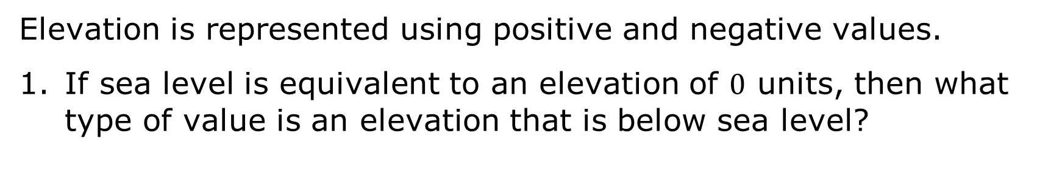
4.6.3 Guided Instruction: Positive and Negative Values in the Real World
Elevation is the vertical distance a location or object is from a given level, such as sea level.
Elevation is represented using positive and negative values.
If sea level is equivalent to an elevation of $0$ units, then what type of value is an elevation that is below sea level?
volume 1, pg. 163

Slide 14
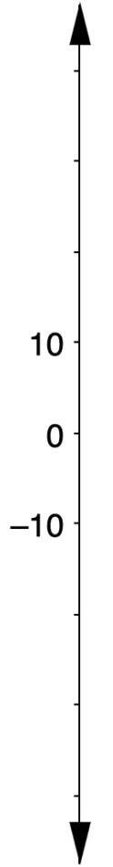
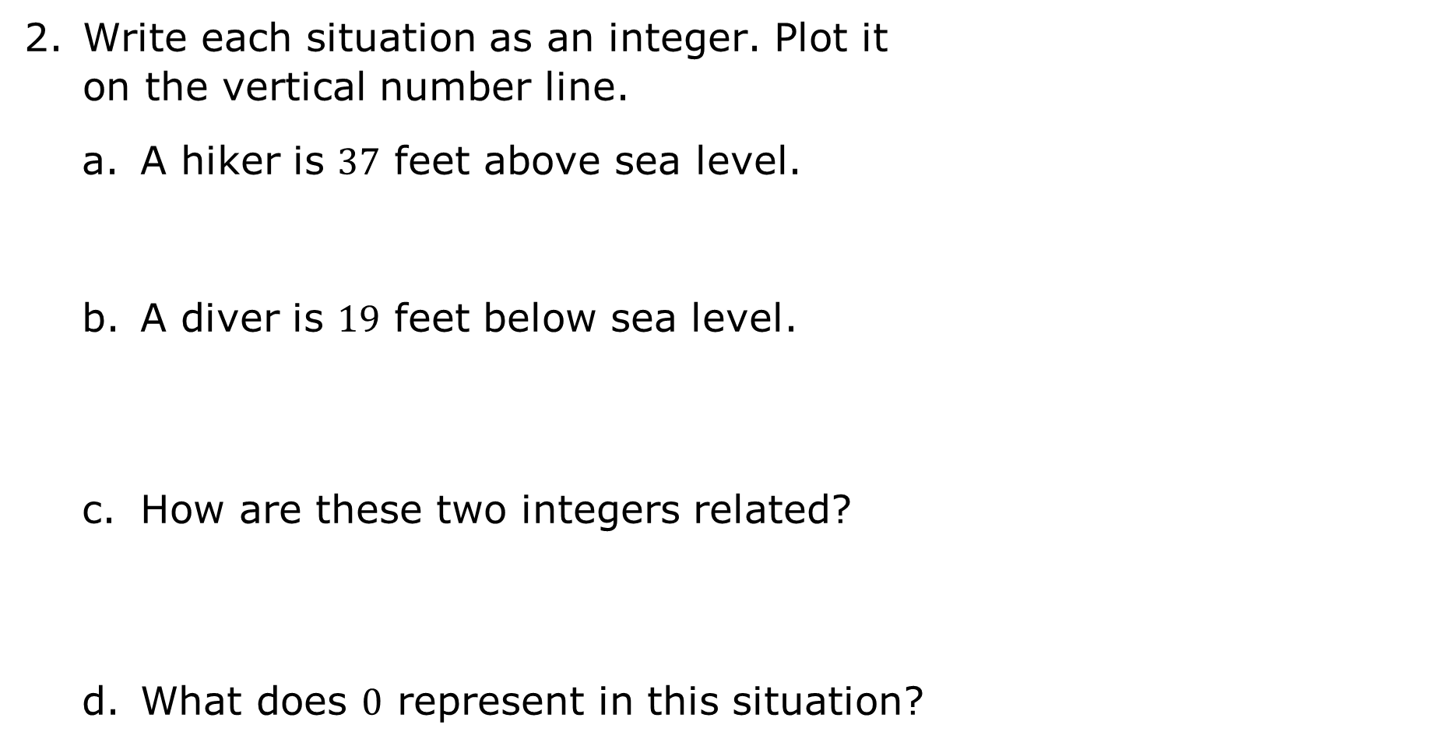
Write each situation as an integer. Plot it on the vertical number line.
A hiker is $37$ feet above sea level.
A diver is $19$ feet below sea level.
How are these two integers related?
What does $0$ represent in this situation?
volume 1, pg. 163

Slide 15
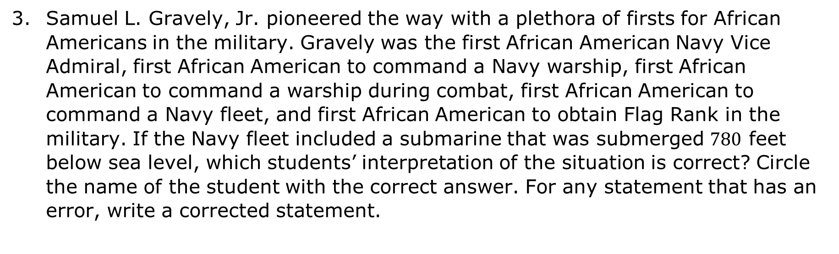
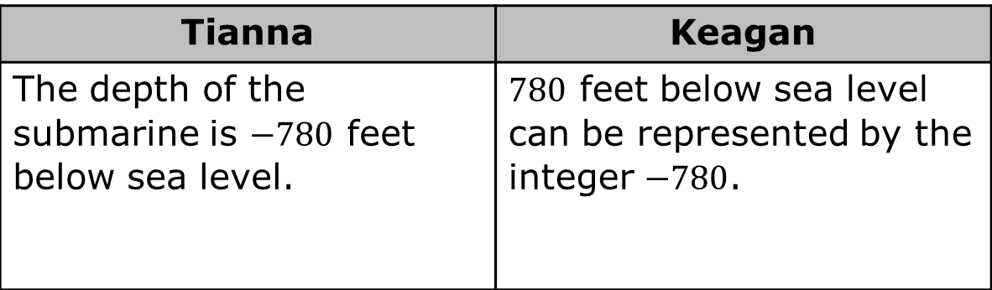
Samuel L. Gravely, Jr. pioneered the way with a plethora of firsts for African Americans in the military. Gravely was the first African American Navy Vice Admiral, first African American to command a Navy warship, first African American to command a warship during combat, first African American to command a Navy fleet, and first African American to obtain Flag Rank in the military. If the Navy fleet included a submarine that was submerged $780$ feet below sea level, which students’ interpretation of the situation is correct? Circle the name of the student with the correct answer. For any statement that has an error, write a corrected statement.
Tianna | Keagan
The depth of the submarine is $−780$ feet below sea level. | $780$ feet below sea level can be represented by the integer $−780$.
volume 1, pg. 163

Slide 16
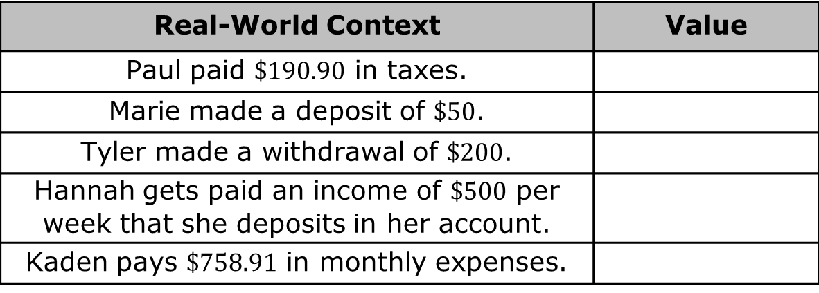
A bank deposit is the amount of money a person gives the bank for safekeeping in their account.
A bank withdrawal is the amount of money removed from a bank account.
An expense is a cost or the amount of money spent.
The following people have money in their bank accounts. Determine the positive and negative values that represent the effect each situation has on their account balance.
Real-World Context | Value
Paul paid $\$190.90$ in taxes.
Marie made a deposit of $\$50$.
Tyler made a withdrawal of $\$200$.
Hannah gets paid an income of $\$500$ per week that she deposits in her account.
Kaden pays $\$758.91$ in monthly expenses.
volume 1, pg. 163

Slide 17
Collaboration
volume 1, pg. 164

Slide 18
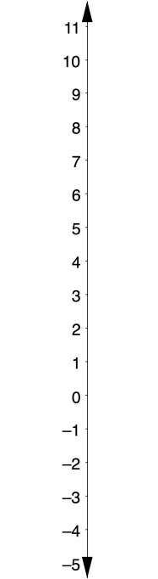
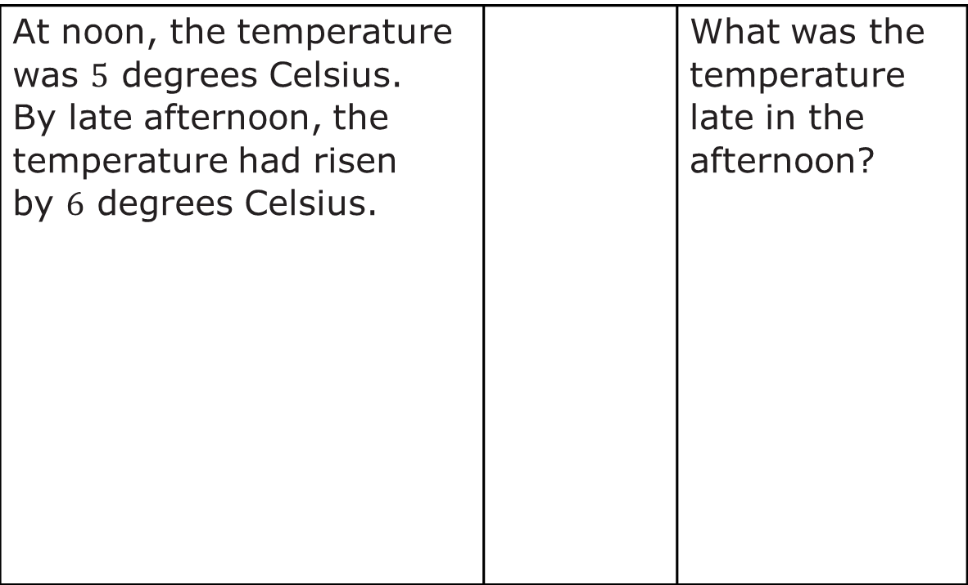
4.6.4 Collaboration: Above or Below Zero
Represent each change in temperature on the number line. Answer the question for each situation.
At noon, the temperature was $5$ degrees Celsius. By late afternoon, the temperature had risen by $6$ degrees Celsius. |  | What was the temperature late in the afternoon?
volume 1, pg. 164

Slide 19

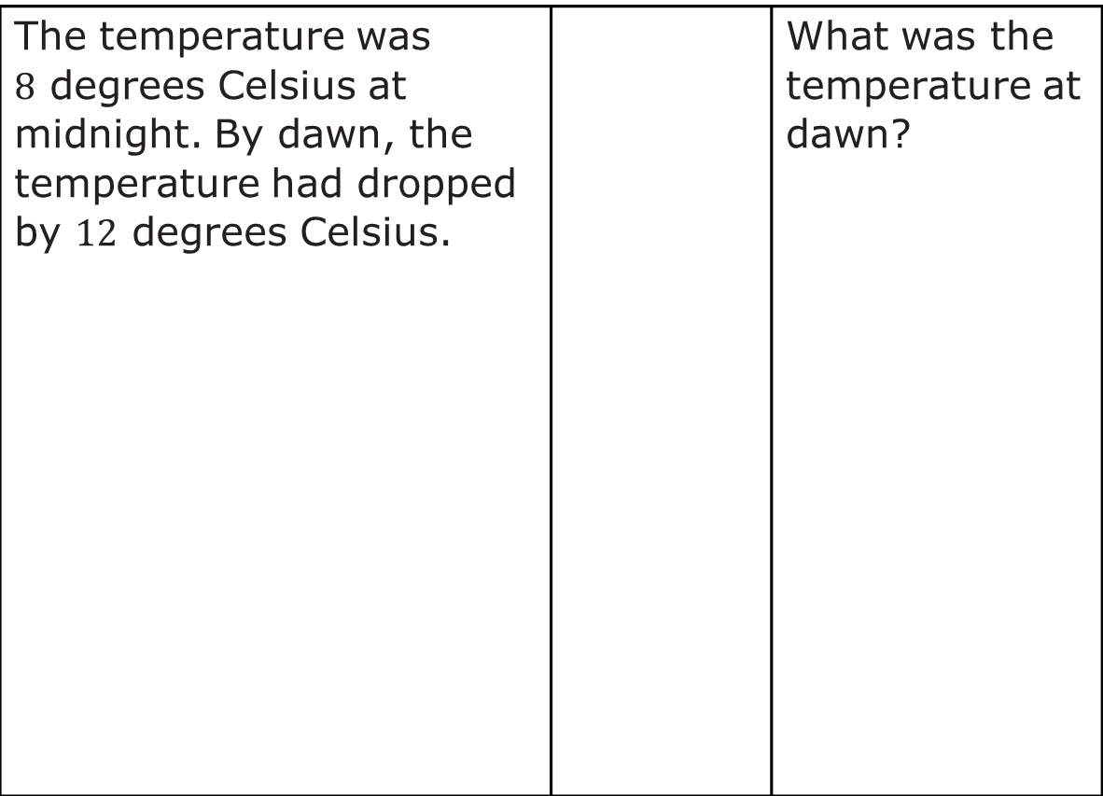
The temperature was $8$ degrees Celsius at midnight. By dawn, the temperature had dropped by $12$ degrees Celsius. |  | What was the temperature at dawn?
volume 1, pg. 164

Slide 20
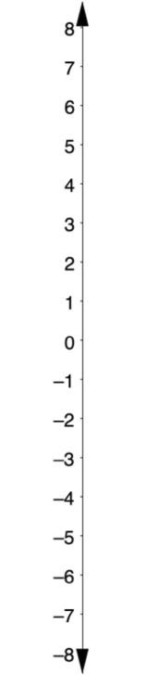
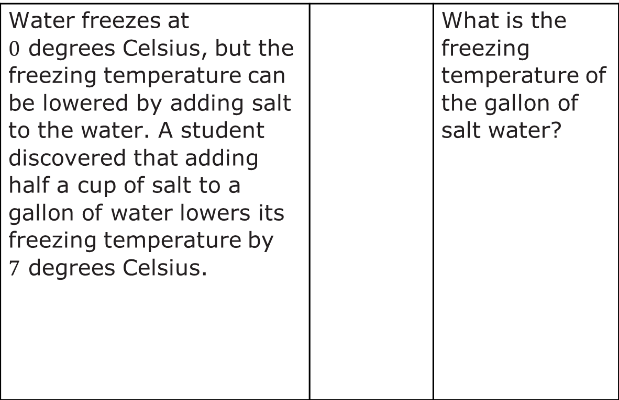
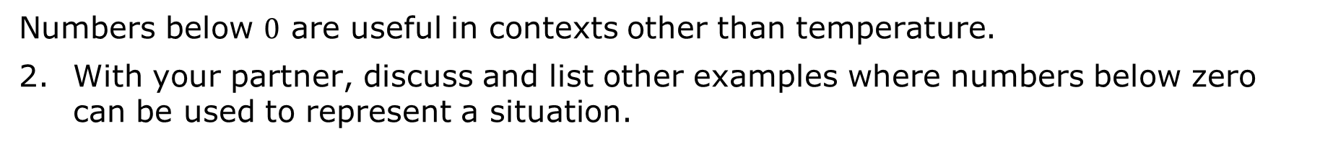
Water freezes at $0$ degrees Celsius, but the freezing temperature can be lowered by adding salt to the water. A student discovered that adding half a cup of salt to a gallon of water lowers its freezing temperature by $7$ degrees Celsius. |  | What is the freezing temperature of the gallon of salt water?
Numbers below $0$ are useful in contexts other than temperature.
With your partner, discuss and list other examples where numbers below zero can be used to represent a situation.
volume 1, pg. 164

Slide 21

Try It
volume 1, pg. 165

Slide 22

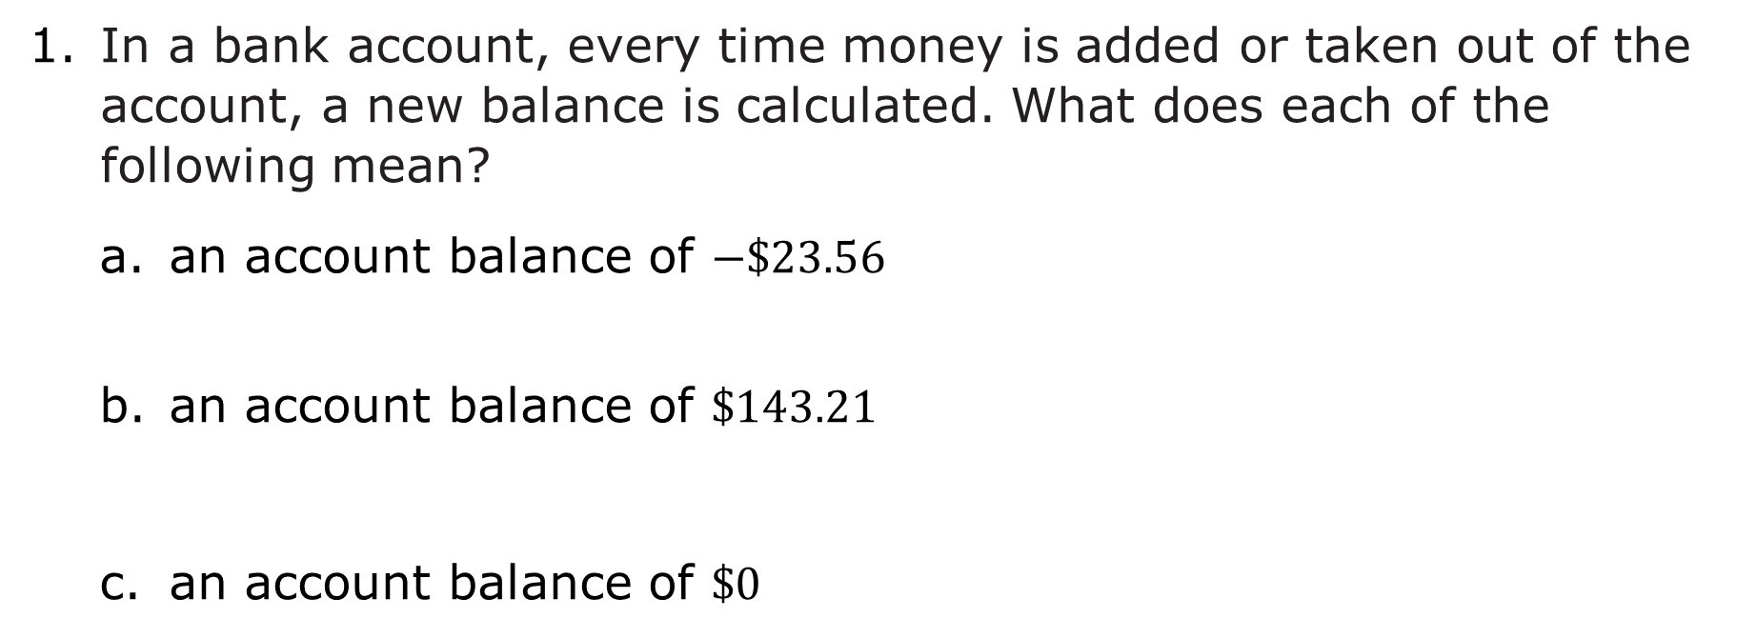
4.6.5 Try It: Representing the Real World with Positive and Negative Values
In a bank account, every time money is added or taken out of the account, a new balance is calculated. What does each of the following mean?
an account balance of $−\$23.56$
an account balance of $\$143.21$
an account balance of $\$0$
volume 1, pg. 165

Slide 23
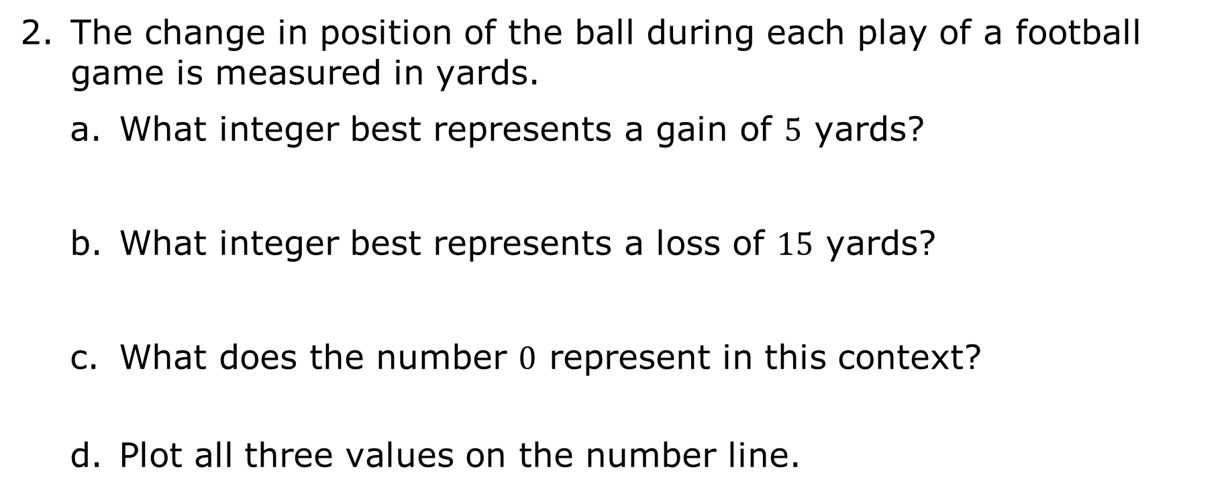
The change in position of the ball during each play of a football game is measured in yards.
What integer best represents a gain of $5$ yards?
What integer best represents a loss of $15$ yards?
What does the number $0$ represent in this context?
Plot all three values on the number line.
volume 1, pg. 165

Slide 24
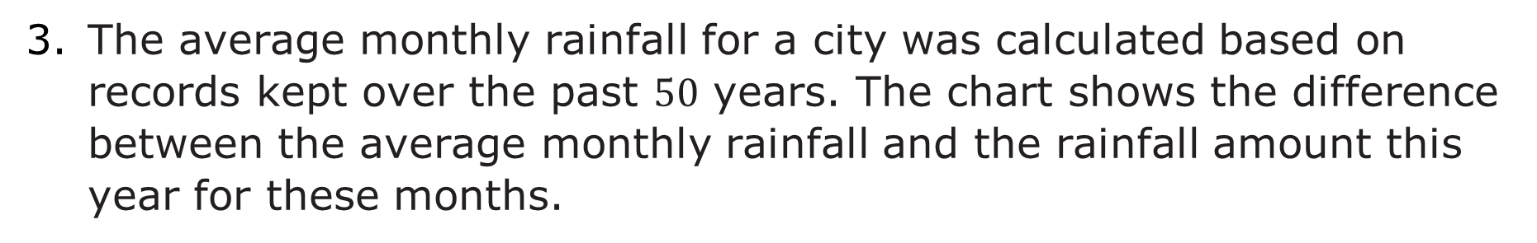
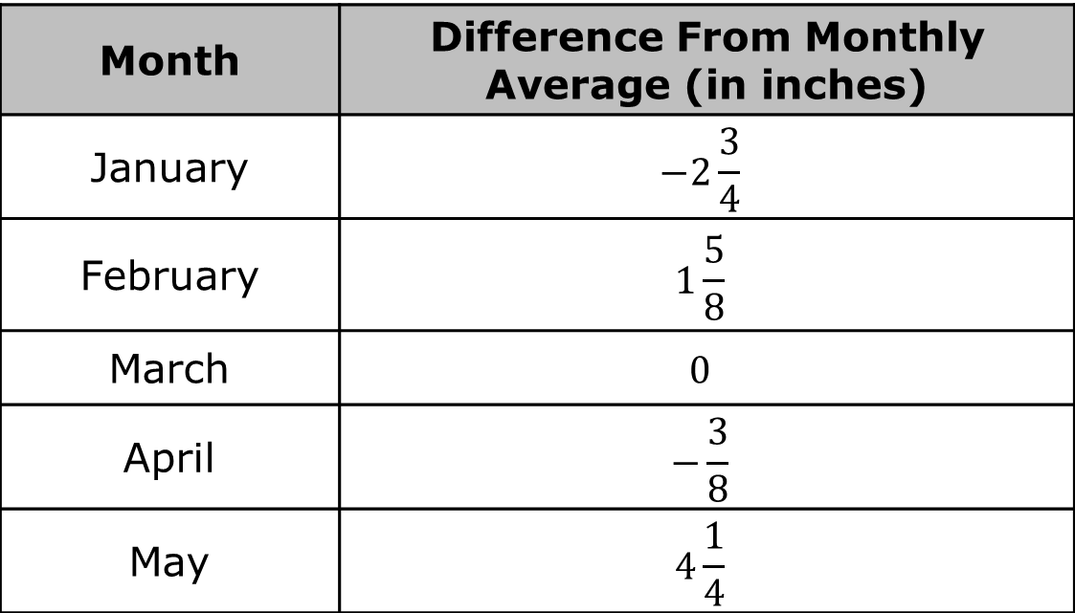
The average monthly rainfall for a city was calculated based on records kept over the past $50$ years. The chart shows the difference between the average monthly rainfall and the rainfall amount this year for these months.
Month | Difference From Monthly Average (in inches)
January | $$−2\frac{3}{4}$$
February | $$1\frac{5}{8}$$
March | $$0$$
April | $$−\frac{3}{8}$$
May | $$4\frac{1}{4}$$
volume 1, pg. 166

Slide 25

Explain what the value in the chart means for the following months in the context of this problem. Then, plot and label each month’s value on the number line.
Month | Interpretation
February
March
April
volume 1, pg. 166

Slide 26

Your Turn
volume 1, pg. 167

Slide 27
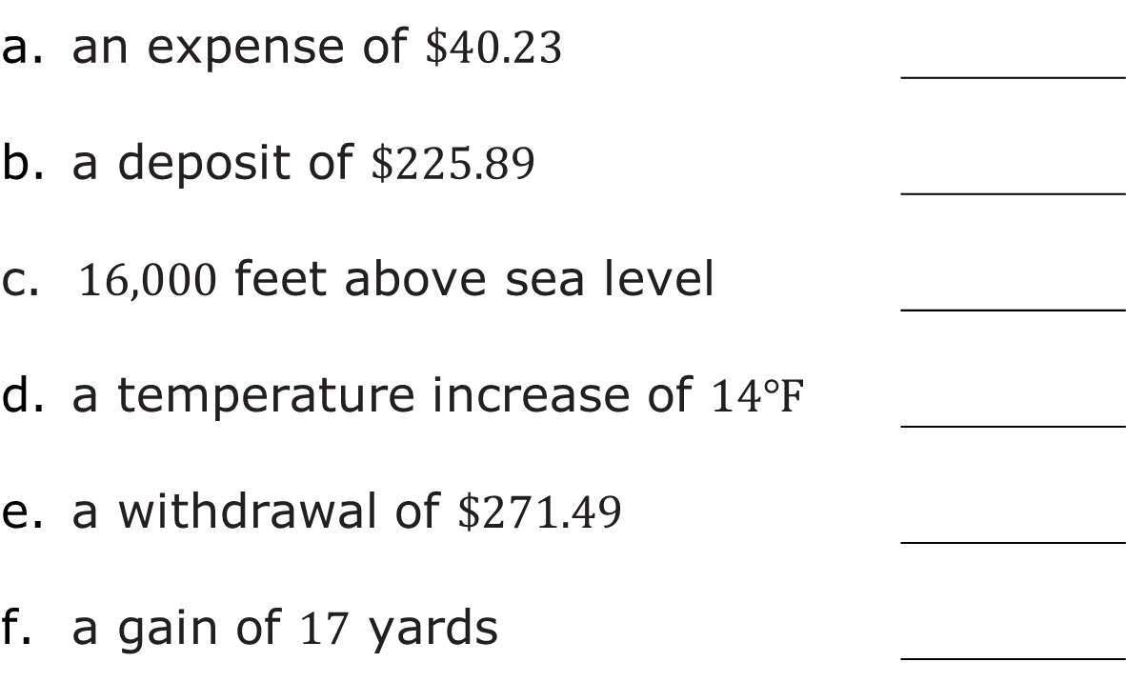
4.6.6 Your Turn!
Write a value that represents each description.
an expense of $\$40.23$
a deposit of $\$225.89$
c. $16,000$ feet above sea level
a temperature increase of $14℉$
a withdrawal of $\$271.49$
a gain of $17$ yards
volume 1, pg. 167

Slide 28


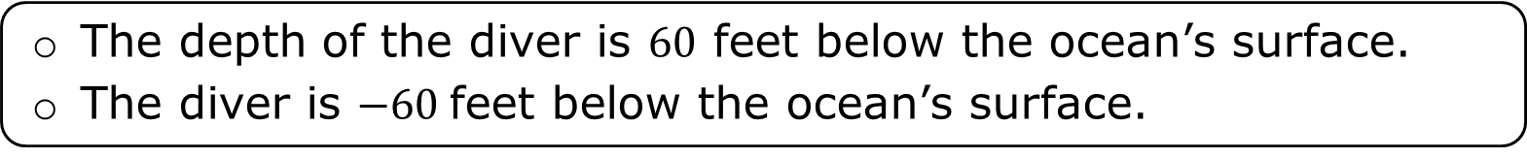
Read each statement and select the correct description of each situation.
A diver is $60$ feet below the surface of the ocean.
The elevation of the bottom of a boat with respect to sea level is given as $−5$ feet.
The depth of the diver is $60$ feet below the ocean’s surface.
The diver is $−60$feet below the ocean’s surface.
The bottom of the boat is $5$ feet above sea level.
The bottom of the boat is $5$ feet below sea level.
volume 1, pg. 167

Slide 29

Wrap-Up
volume 1, pg. 167

Slide 30
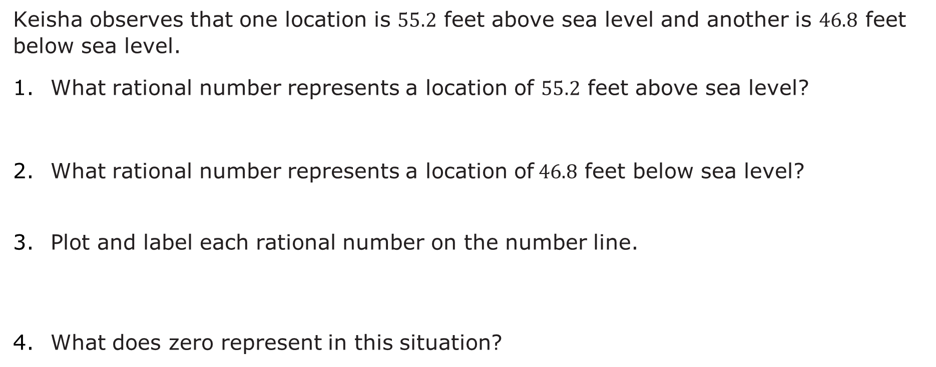
4.6.7 Wrap-Up: Ticket Out the Door
Keisha observes that one location is $55.2$ feet above sea level and another is $46.8$ feet below sea level.
What rational number represents a location of $55.2$ feet above sea level?
What rational number represents a location of$46.8$ feet below sea level?
Plot and label each rational number on the number line.
What does zero represent in this situation?
volume 1, pg. 167

